Slide 1
Data Structures
Algorithm Analysis

Slide 2
Program = algorithm + Data Structure
Processing
Input
Output

Slide 3
Algorithm is a set of instructions (steps) written to carry out certain tasks.
There can be more than one solution (more than one algorithm) to solve a given problem.
An algorithm can be implemented using different programming languages on different platforms.
An algorithm must be correct. It should correctly solve the problem.
Once we have a correct algorithm for a problem, we have to determine the efficiency of that algorithm.

Slide 4
An important question is: How efficient is an algorithm or piece of code?
Efficiency covers lots of resources, including:
CPU (time) usage
Memory usage
Disk usage
Network usage

Slide 5
There are two aspects of algorithmic performance:
Time
Instructions take time.
How fast does the algorithm perform?
What affects its runtime?
Space
Data structures take space
What kind of data structures can be used?
How does choice of data structure affect the runtime?
Focus on time:
How to estimate the time required for an algorithm
How to reduce the time required
5

Slide 6
The effectiveness of the algorithm or the analysis of the performance of an algorithm mainly concerns two things:
The complexity of space and
The complexity of time.
Space Complexity
Space complexity is defined as the total amount of primary memory a program needs to run to its completion.
Components of Program Space
Program space covers instruction space, data space and stack space depicted as follows:
Program space = Instruction space + data space + stack space.

Slide 7
Time Complexity
The amount of time it takes for an algorithm to run is called as time complexity.
Absolute time complexity is defined as follows:
Absolute time complexity = number of instructions
× time taken to execute one instruction

Slide 8
Be careful to differentiate between:
Performance: how much time/memory/disk/... is actually used when a program is running. This depends on the machine, compiler, etc., as well as the code.
Complexity: how do the resource requirements of a program or algorithm scale, i.e., what happens as the size of the problem being solved gets larger.
Complexity affects performance but not the other way around. The time required by a method is proportional to the number of “basic operations” that it performs.

Slide 9
Some examples of basic operations:
one arithmetic operation (e.g., +, *).
one assignment
one test (e.g., x == 0)
one read
one write (of a primitive type)

Slide 10
Analysis of Algorithms
Analysis of Algorithms is the area of computing that provides tools to analyze the efficiency of different methods of solutions.
How to compare the time efficiency of two algorithms that solve the same problem?
Naïve Approach: implement these algorithms in a programming language and run them to compare their time requirements.
Comparing the programs (instead of algorithms) has difficulties.
How are the algorithms coded?
Comparing running times means comparing the implementations.
We should not compare implementations, because they are sensitive to programming style that may cloud the issue of which algorithm is inherently more efficient.
10

Slide 11
What computer should we use?
We should compare the efficiency of the algorithms independently of a particular computer.
What data should the program use?
Any analysis must be independent of specific data.

Slide 12
When we analyze algorithms, we should employ mathematical techniques that analyze algorithms independently of specific implementations, computers, or data.
To analyze algorithms:
First, we start to count the number of significant operations in a particular solution to assess its efficiency.
Then, we will express the efficiency of algorithms using growth functions.
12

Slide 13
The Execution Time of Algorithms
Each operation in an algorithm (or a program) has a cost.
Each operation takes a certain of time.
count = count + 1; take a certain amount of time, but it is constant
A sequence of operations:
count = count + 1; Cost: c₁
sum = sum + count; Cost: c₂
Total Cost = c₁ + c₂

Slide 14
Example: Simple If-Statement
Cost Times
if (n < 0) c1 1
absval = -n c2 1
else
absval = n; c3 1
Total Cost <= c1 + max(c2,c3)

Slide 15
Example: Simple Loop
Cost Times
i = 1; c1 1
sum = 0; c2 1
while (i <= n) { c3 n+1
i = i + 1; c4 n
sum = sum + i; c5 n
}
Total Cost = c1 + c2 + (n+1)*c3 + n*c4 + n*c5
The time required for this algorithm is proportional to n
15

Slide 16
Example: Nested Loop
Cost Times
i=1; c1 1
sum = 0; c2 1
while (i <= n) { c3 n+1
j=1; c4 n
while (j <= n) { c5 n*(n+1)
sum = sum + i; c6 n*n
j = j + 1; c7 n*n
}
i = i + 1; c8 n
}
Total Cost = c1 + c2 + (n+1)*c3 + n*c4 +n*(n+1)*c5+n*n*c6+n*n*c7+n*c8
The time required for this algorithm is proportional to n²
16

Slide 17
General Rules for Estimation
Loops: The running time of a loop is at most the running time of the statements inside of that loop times the number of iterations.
Nested Loops: Running time of a nested loop containing a statement in the inner most loop is the running time of statement multiplied by the product of the sized of all loops.
Consecutive Statements: Just add the running times of those consecutive statements.
If/Else: Never more than the running time of the test plus the larger of running times of S1 and S2.

Slide 18
Algorithm Growth Rates
We measure an algorithm’s time requirement as a function of the problem size.
Problem size depends on the application: e.g. number of elements in a list for a sorting algorithm, the number users for a social network search.
So, for instance, we say that (if the problem size is n)
Algorithm A requires 5*n² time units to solve a problem of size n.
Algorithm B requires 7*n time units to solve a problem of size n.
The most important thing to learn is how quickly the algorithm’s time requirement grows as a function of the problem size.
Algorithm A requires time proportional to n².
Algorithm B requires time proportional to n.
An algorithm’s proportional time requirement is known as growth rate.

Slide 19
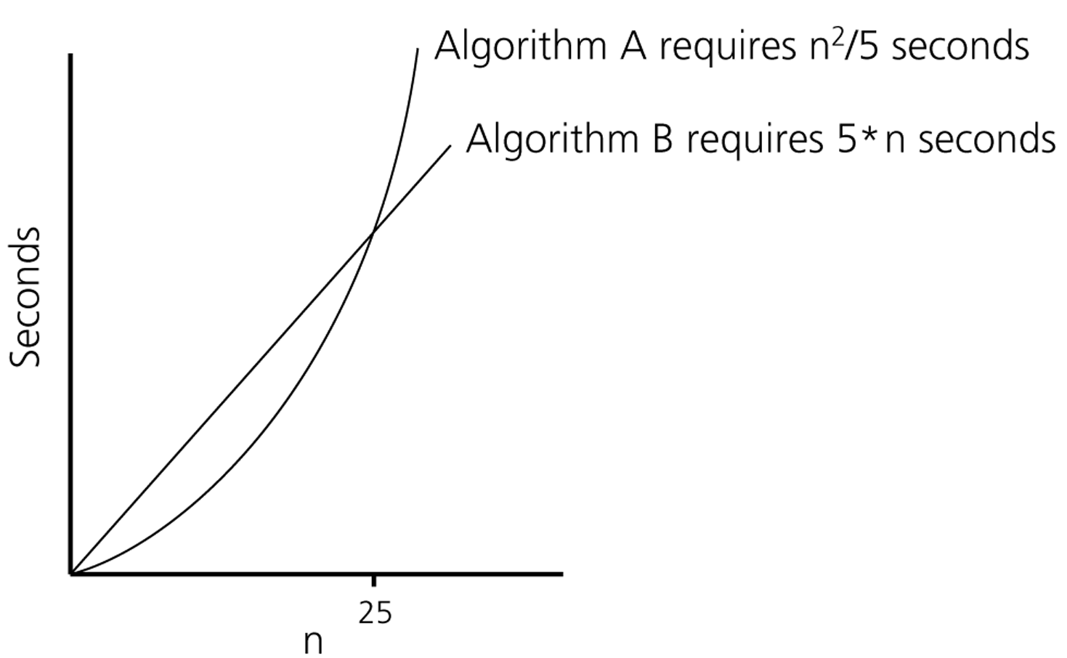
Time requirements as a function
of the problem size n
19

Slide 20
Common Growth Rates
Function | Growth Rate Name
c | Constant
log N | Logarithmic
log² N | Log-squared
N | Linear
N log N | Log-linear
N² | Quadratic
N³ | Cubic
2^{N} | Exponential

Slide 21
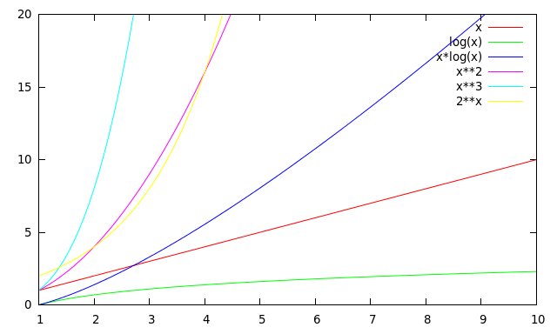
Running Times for Small Inputs
Running time
Input size (x = n)

Slide 22
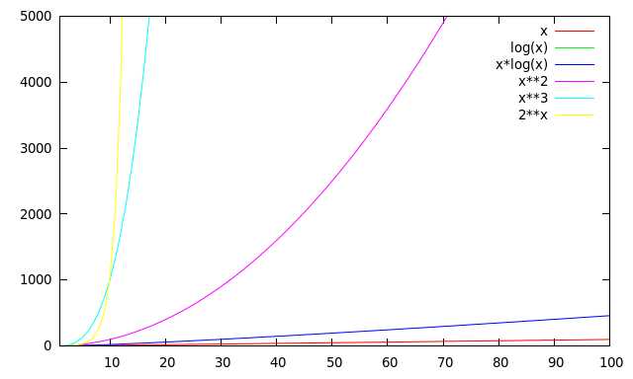
Running Times for Large Inputs
Running time
Input size (x = n)

Slide 23
Order-of-Magnitude Analysis and Big O Notation
If Algorithm A requires time proportional to g(n), Algorithm A is said to be order g(n), and it is denoted as O(g(n)).
The function g(n) is called the algorithm’s growth-rate function.
Since the capital O is used in the notation, this notation is called the Big O notation.
If Algorithm A requires time proportional to n², it is O(n²).
If Algorithm A requires time proportional to n, it is O(n).

Slide 24
Definition of the Order of an Algorithm
Definition:
Algorithm A is order g(n) – denoted as O(g(n)) if constants k and n₀ exist such that A requires no more than k*g(n) time units to solve a problem of size n ≥ n₀. ➔ f(n) ≤ k*g(n) for all n ≥ n₀
The requirement of n ≥ n₀ in the definition of O(f(n)) formalizes the notion of sufficiently large problems.
In general, many values of k and n can satisfy this definition.

Slide 25
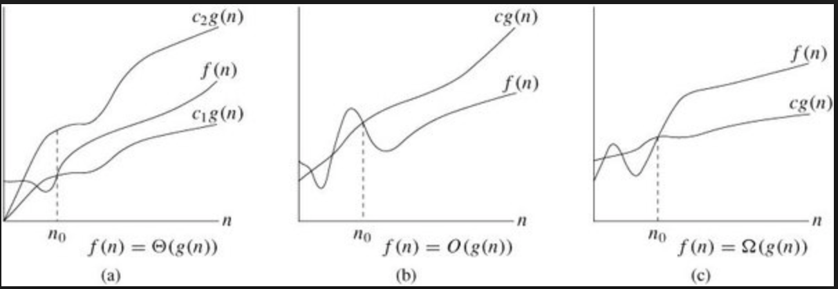
Definition of the Order of an Algorithm
Definition:
Algorithm A is omega g(n) – denoted as Ω(g(n)) if constants k and n₀ exist such that A requires more than k*g(n) time units to solve a problem of size n ≥ n₀. ➔ f(n) ≥ k*g(n) for all n ≥ n₀
25

Slide 26
Definition of the Order of an Algorithm
Definition:
Algorithm A is theta g(n) – denoted as 𝚹(g(n)) if constants k₁, k₂ and n₀ exist such that k₁*g(n) ≤ f(n) ≤ k₂*g(n) for all n ≥ n₀
(Drop the equalities and you get small o and small omega (ω) notations, respectively, e.g., f(n) is o(g(n)) if f(n)<kg(n))
26

Slide 27
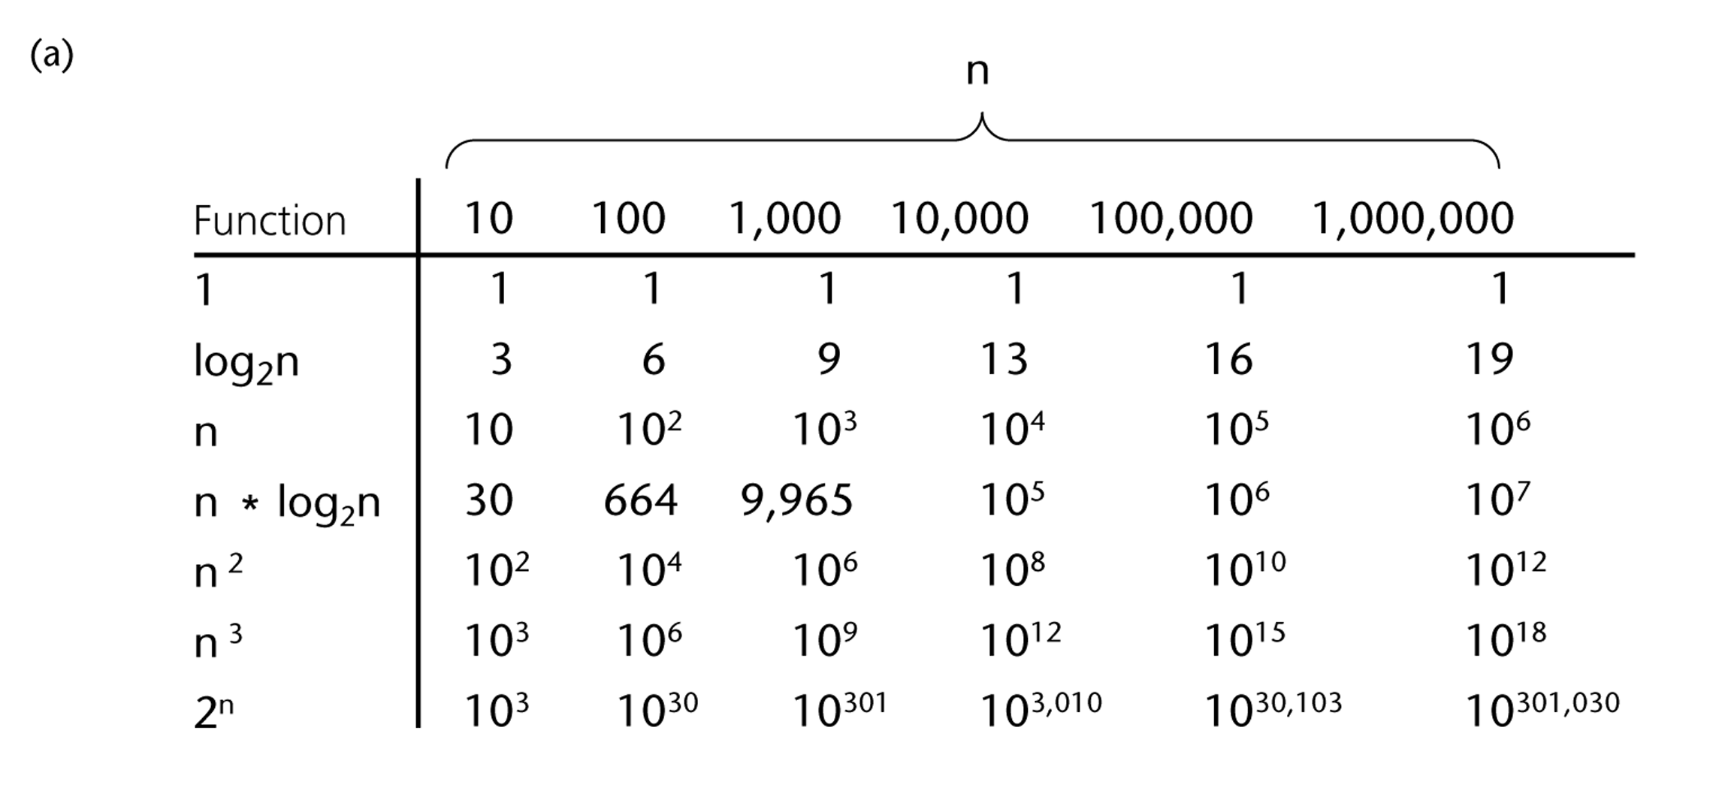
A Comparison of Growth-Rate Functions
27

Slide 28
Growth-Rate Functions
O(1) Time requirement is constant, and it is independent of the problem’s size.
O(log₂n) Time requirement for a logarithmic algorithm increases increases slowly as the problem size increases.
O(n) Time requirement for a linear algorithm increases directly with the size of the problem.
O(n*log₂n) Time requirement for a n*log₂n algorithm increases more rapidly than a linear algorithm.
O(n²) Time requirement for a quadratic algorithm increases rapidly with the size of the problem.
28

Slide 29
O(n³) Time requirement for a cubic algorithm increases more rapidly with the size of the problem than the time requirement for a quadratic algorithm.
O(2^{n}) As the size of the problem increases, the time requirement for an exponential algorithm increases too rapidly to be practical.

